Slide 1
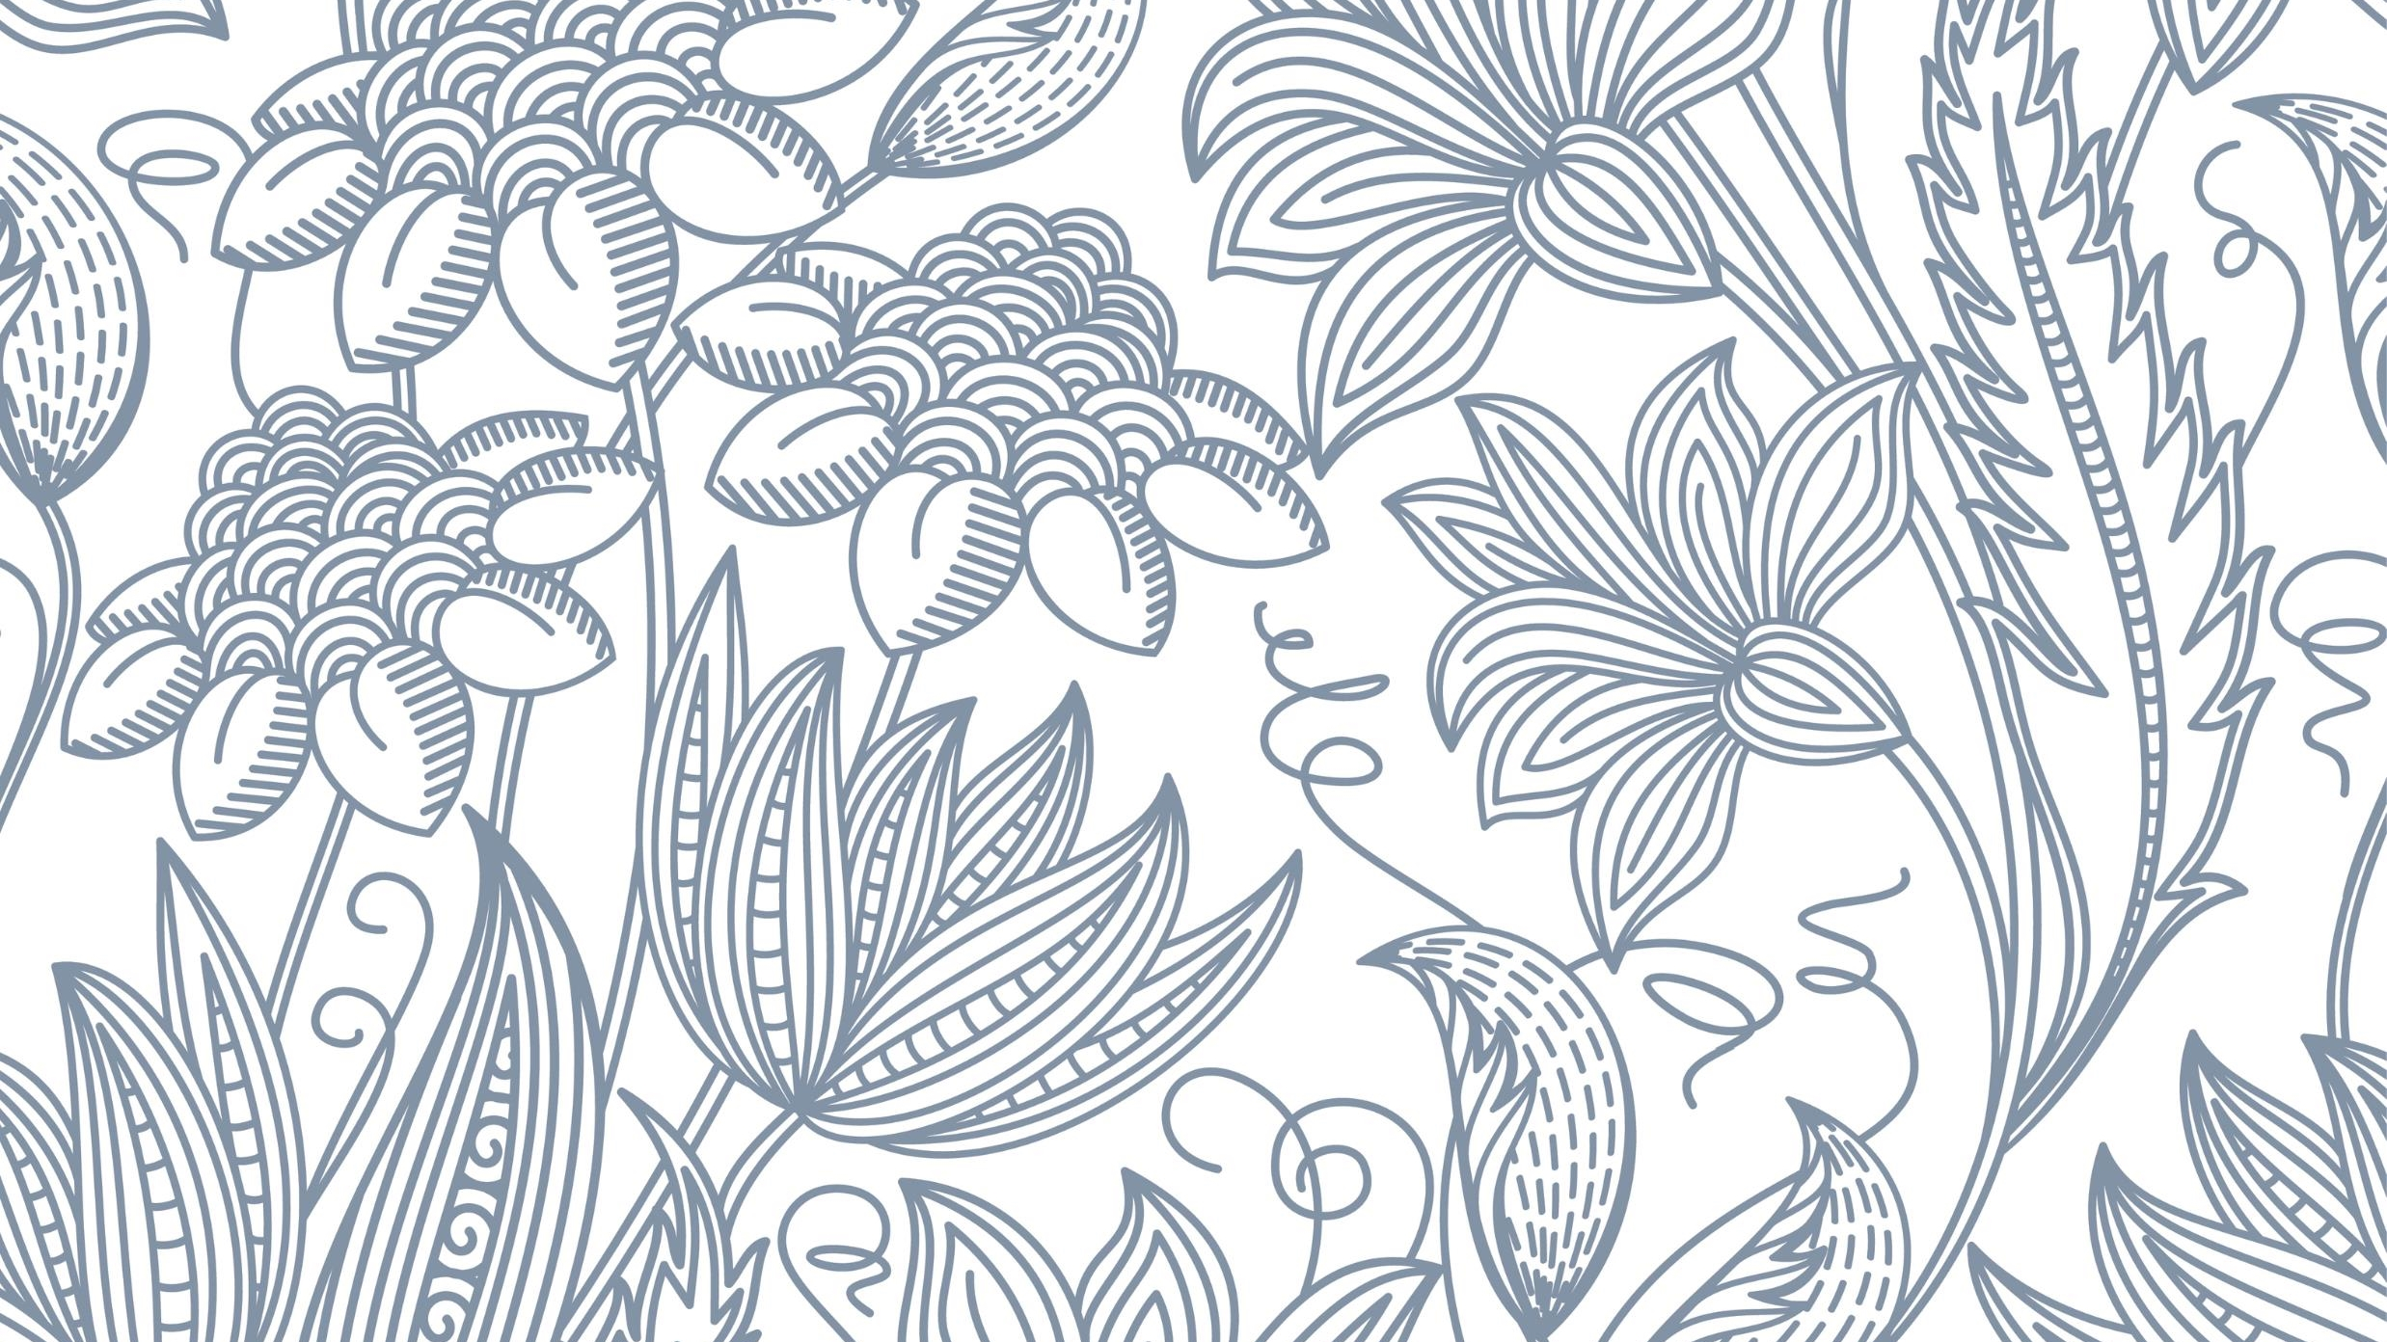
Siam weed down-sampling
James Currie s3901655

Slide 2
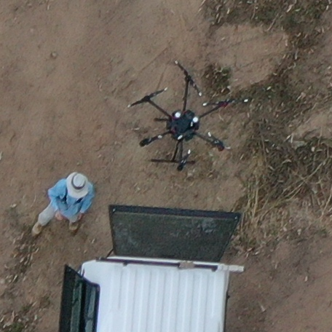
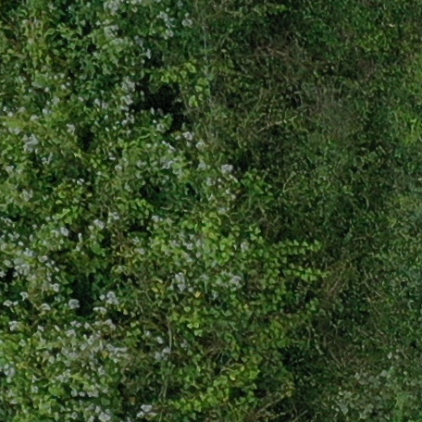
Original

Slide 3
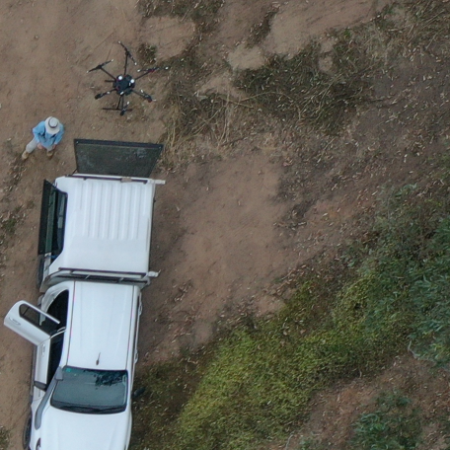
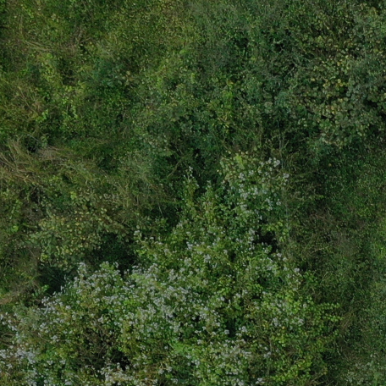
Down-sampled by 2 (PIXEL_AGG)

Slide 4
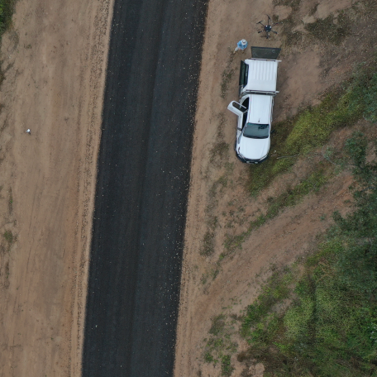
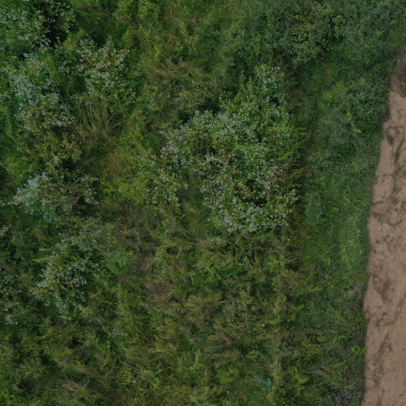
Down-sampled by 5 (PIXEL_AGG)

Slide 5
Down-sampled by 3 Comparison

Slide 6
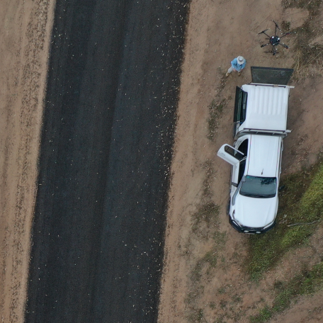
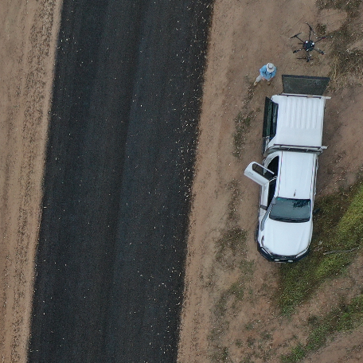
PIXEL_AGG INTER_LANCZOS

Slide 7
PIXEL_AGG INTER_LANCZOS

Slide 8
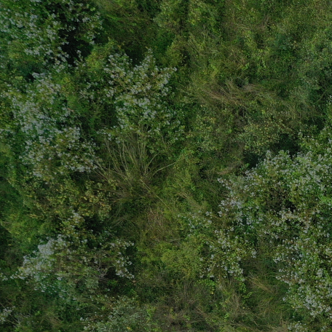

PIXEL_AGG INTER_LANCZOS

Slide 9
PIXEL_AGG INTER_LANCZOS

Slide 10
Down-sampled by 5 Comparison

Slide 11
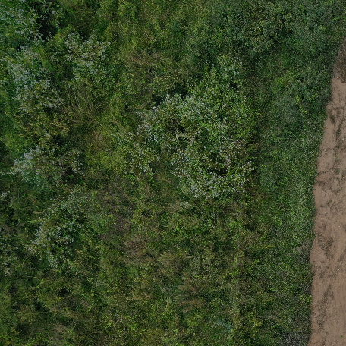
PIXEL_AGG INTER_CUBIC

Slide 12

PIXEL_AGG INTER_LINEAR

Slide 13

PIXEL_AGG INTER_LANZCOS

Slide 14
PIXEL_AGG PIXEL_AGG

